Slide 1
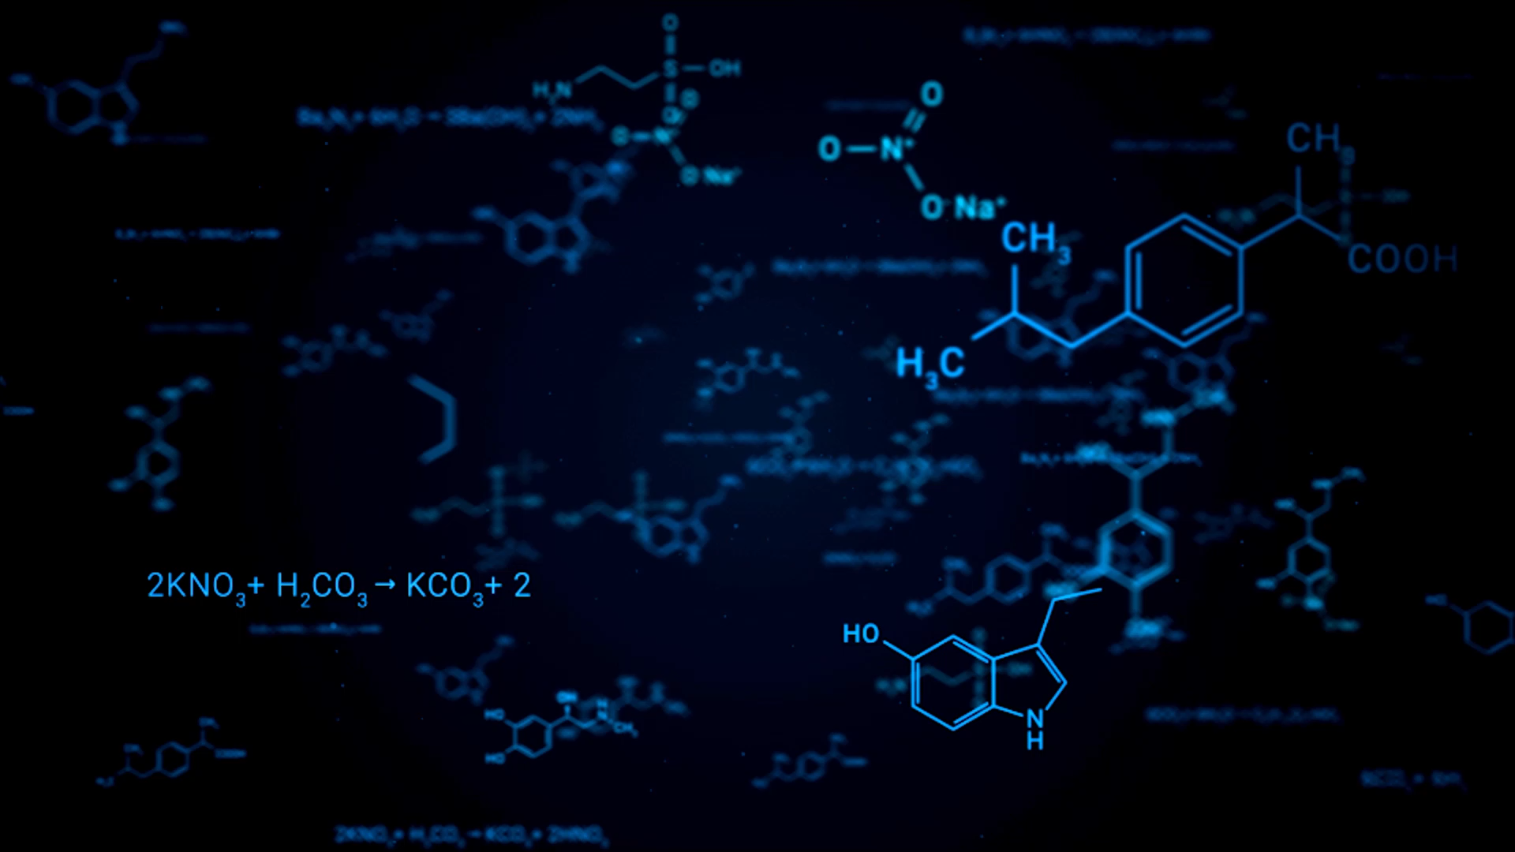
(Hyper)Priors Sensitivity Analysis
Bowen He
Department of Civil and Environmental Engineering
Vanderbilt University

Slide 2
Contents
Prior sensitivity analysis of HPSDRM on the case study (population in the Davidson County, Nashville)
(1) Base Scenario;
(2) Scenario 1: change (hyper)priors on CAR hyperparameters;
(3) Scenario 2: change (hyper)priors on CAR hyperparameters, enlarge logit lambda’s normal prior’s SD to 8;
(4) Scenario 3: change (hyper)priors on CAR hyperparameters, enlarge logit lambda’s normal prior’s SD to 15;
(5) Scenario 4: change (hyper)priors on CAR hyperparameters, enlarge logit lambda’s normal prior’s SD to 15, enlarge precision’s gamma prior’s SD to 4;
(6) Scenario 5: change (hyper)priors on CAR hyperparameters, enlarge logit lambda normal prior’s SD to 15, enlarge precision’s gamma prior’s SD to 8;
Prior sensitivity analysis of Leroux CAR model simulation:
(1) Base Scenario;
(2) Scenario 1: Logit Lambda SD to 1;
(3) Scenario 2: Logit Lambda and Precision SD to 1;
(4) Scenario 3: Precision’s Gamma prior’s mode on true precision;
(5) Scenario 4: Precision’s Gamma prior’s mode on the true precision, enlarge logit-lambda’s normal prior’s SD to 2;
Prior sensitivity analysis of integrated Matérn field and Leroux CAR model simulation:
(1) Base Scenario;
(2) Scenario 1: All SD to 1 except precision’s Gamma prior;
(3) Scenario 2: All SD to 1;
(4) Scenario 3: All SD to 1 and Gamma prior’s mode on the true precision;
(5) Scenario 4: All normal priors’ SD to 1 and Gamma prior’s mode on the true precision, enlarge logit lambda’s normal prior’s SD to 2;
Conclusion
Reference

Slide 3
Base Scenario
(Hyper)Priors Summary
Parameter | Family | Prior parameters
Intercept | Gaussian | mean = 0, sd = 2
LC (DOS, DLI, DMI) | Gaussian | mean = 0, sd = 1
Range (Matérn) | PC | min = 1.5, prob = 0.01
Sigma (Matérn) | PC | max = 0.25, prob = 0.01
Logit Lambda (CAR) | Gaussian | mean = logit(0.8), sd = 1
Precision (CAR) | Gamma | shape = 10, scale = 1

Slide 4
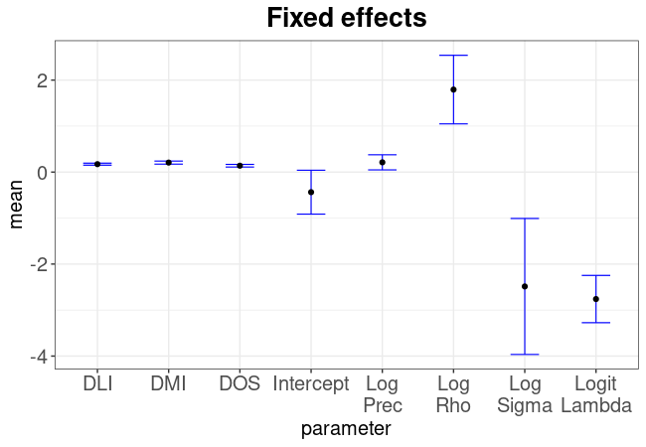
Model Fitting Posterior Summary: Model (Hyper)Parameters Posterior Samples
Model Parameters
Fixed Effects | Mean | Std. Error
Intercept | -0.44 | 0.48
DOS | 0.14 | 0.03
DLI | 0.17 | 0.02
DMI | 0.21 | 0.03
Log-Sigma | -2.49 | 1.48
Log-Rho | 1.79 | 0.75
Logit-Lambda | -2.76 | 0.51
Log-Precision | 0.21 | 0.16
Objective Function-Negative Log Likelihood (NLL) | -10570.05 | NA
Priors-Negative Log Likelihood (NLL Priors) | -11449.5 | NA
Out Sample (block) Performance |  | Value
R² |  | 0.7
RMSE |  | 99.89
MAE |  | 42.44
Pearson |  | 0.84
Spearman |  | 0.75
Log-Pearson |  | 0.76

Slide 5
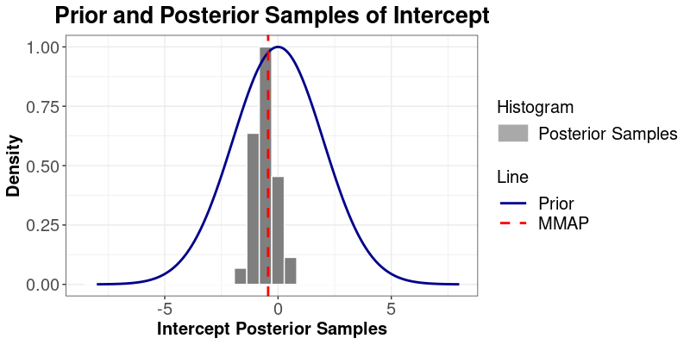
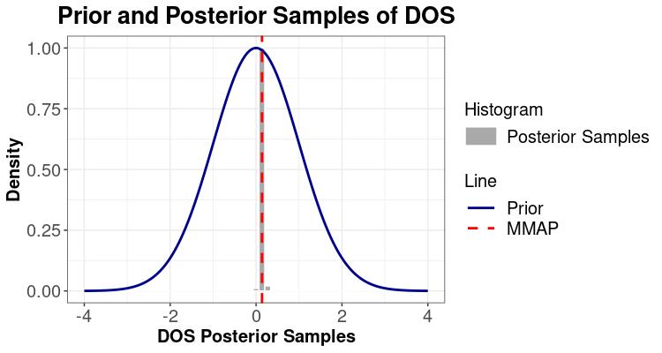
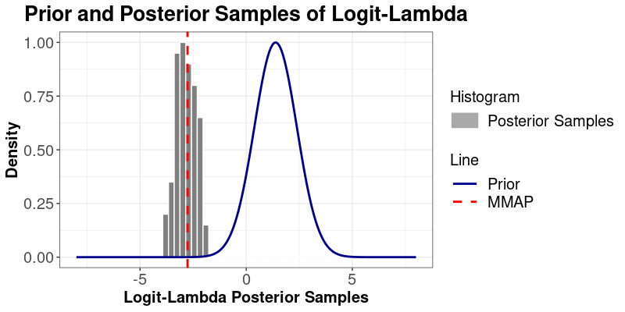
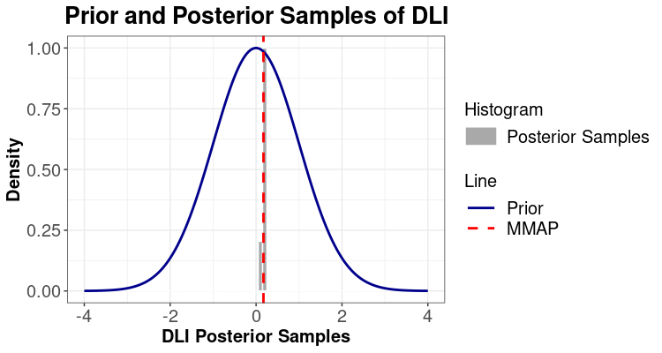

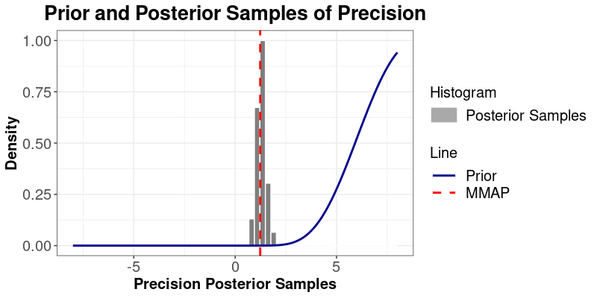
Prior and Posterior

Slide 6
Scenario 1: change (hyper)priors on CAR hyperparameters
(Hyper)Priors Summary
Parameter | Family | Prior parameters
Intercept | Gaussian | mean = 0, sd = 2
LC (DOS, DLI, DMI) | Gaussian | mean = 0, sd = 1
Range (Matérn) | PC | min = 1.5, prob = 0.01
Sigma (Matérn) | PC | max = 0.25, prob = 0.01
Logit Lambda (CAR) | Gaussian | mean = logit(0.5), sd = 3
Precision (CAR) | Gamma | shape = 1, scale = 2

Slide 7
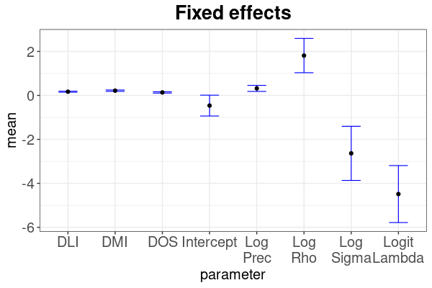
Model Fitting Posterior Summary: Model (Hyper)Parameters Posterior Samples
Model Parameters
Fixed Effects | Mean | Std. Error
Intercept | -0.46 | 0.47
DOS | 0.14 | 0.03
DLI | 0.17 | 0.02
DMI | 0.22 | 0.03
Log-Sigma | -2.64 | 1.23
Log-Rho | 1.81 | 0.78
Logit-Lambda | -4.49 | 1.30
Log-Precision | 0.32 | 0.14
Objective Function-Negative Log Likelihood (NLL) |  | NA
Priors-Negative Log Likelihood (NLL Priors) |  | NA
Out Sample (block) Performance |  | Value
R² |  | 0.7
RMSE |  | 99.34
MAE |  | 42.38
Pearson |  | 0.84
Spearman |  | 0.75
Log-Pearson |  | 0.76

Slide 8
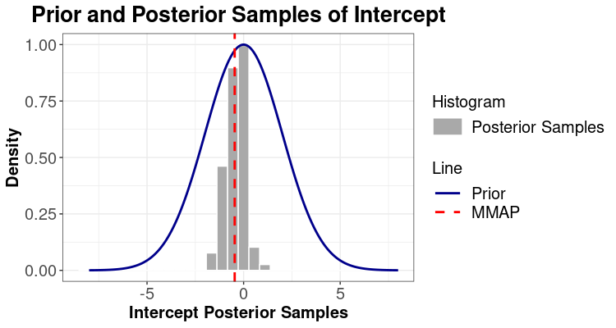

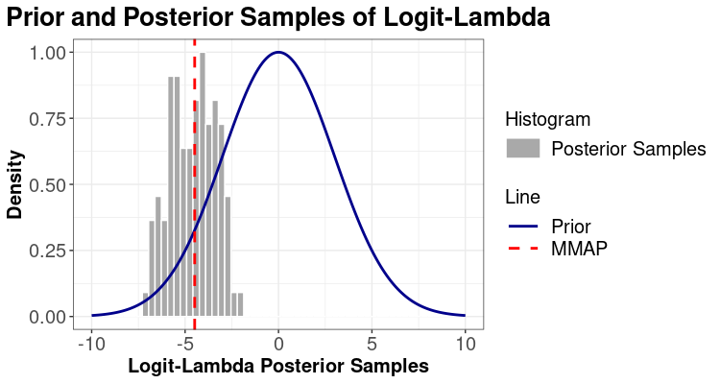
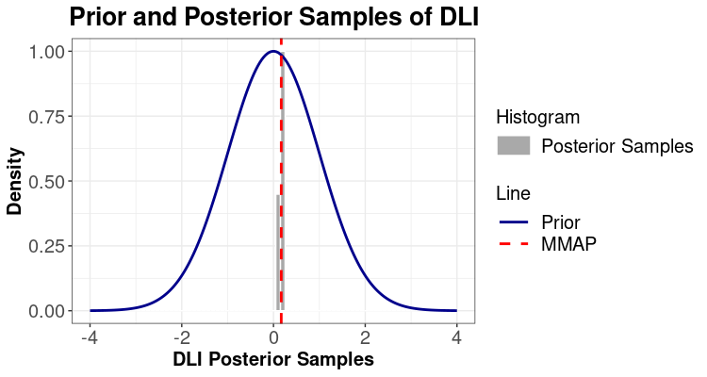
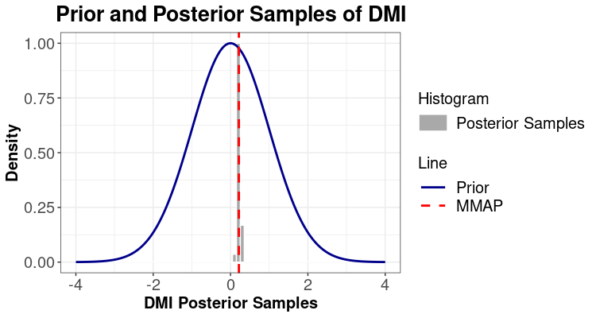
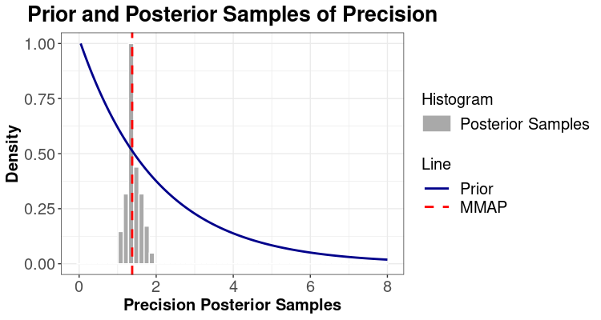
Prior and Posterior

Slide 9
Scenario 2: change (hyper)priors on CAR hyperparameters, enlarge logit lambda normal prior’s SD to 8
(Hyper)Priors Summary
Parameter | Family | Prior parameters
Intercept | Gaussian | mean = 0, sd = 2
LC (DOS, DLI, DMI) | Gaussian | mean = 0, sd = 1
Range (Matérn) | PC | min = 1.5, prob = 0.01
Sigma (Matérn) | PC | max = 0.25, prob = 0.01
Logit Lambda (CAR) | Gaussian | mean = logit(0.5), sd = 8
Precision (CAR) | Gamma | shape = 1, scale = 2

Slide 10
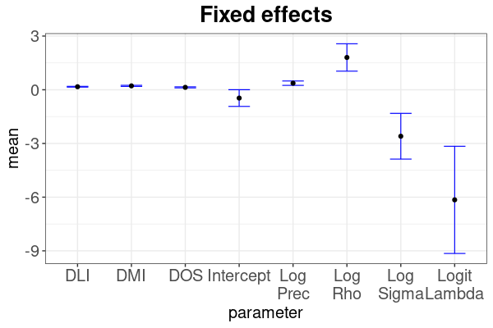
Model Fitting Posterior Summary: Model (Hyper)Parameters Posterior Samples
Model Parameters
Fixed Effects | Mean | Std. Error
Intercept | -0.46 | 0.47
DOS | 0.13 | 0.03
DLI | 0.17 | 0.02
DMI | 0.22 | 0.03
Log-Sigma | -2.60 | 1.28
Log-Rho | 1.80 | 0.76
Logit-Lambda | -6.15 | 2.99
Log-Precision | 0.37 | 0.12
Objective Function-Negative Log Likelihood (NLL) |  | NA
Priors-Negative Log Likelihood (NLL Priors) |  | NA
Out Sample (block) Performance |  | Value
R² |  | 0.70
RMSE |  | 99.27
MAE |  | 42.39
Pearson |  | 0.84
Spearman |  | 0.75
Log-Pearson |  | 0.75

Slide 11
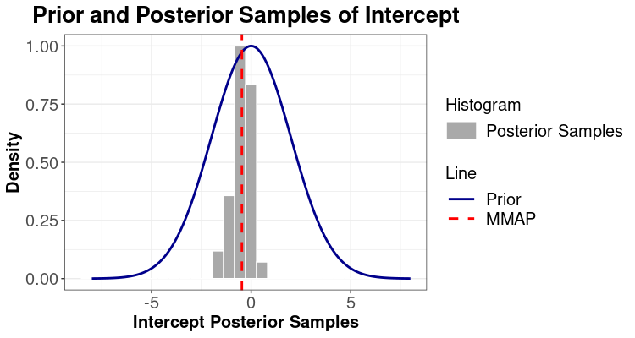

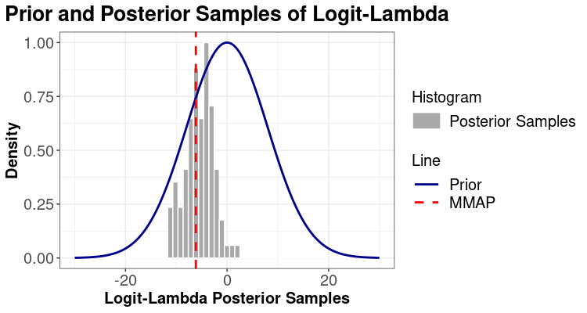


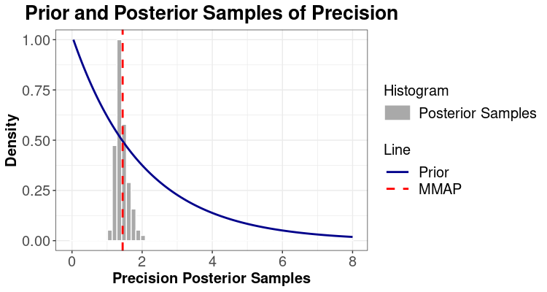
Prior and Posterior

Slide 12
Scenario 3: change (hyper)priors on CAR hyperparameters, enlarge logit lambda normal prior’s SD to 15
(Hyper)Priors Summary
Parameter | Family | Prior parameters
Intercept | Gaussian | mean = 0, sd = 2
LC (DOS, DLI, DMI) | Gaussian | mean = 0, sd = 1
Range (Matérn) | PC | min = 1.5, prob = 0.01
Sigma (Matérn) | PC | max = 0.25, prob = 0.01
Logit Lambda (CAR) | Gaussian | mean = logit(0.5), sd = 15
Precision (CAR) | Gamma | shape = 1, scale = 2

Slide 13
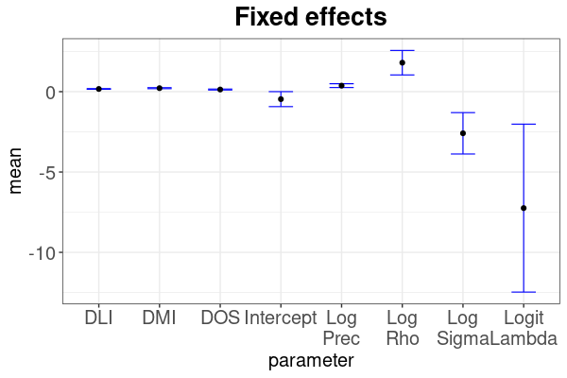
Model Fitting Posterior Summary: Model (Hyper)Parameters Posterior Samples
Model Parameters
Fixed Effects | Mean | Std. Error
Intercept | -0.46 | 0.47
DOS | 0.13 | 0.03
DLI | 0.17 | 0.02
DMI | 0.22 | 0.03
Log-Sigma | -2.59 | 1.29
Log-Rho | 1.80 | 0.76
Logit-Lambda | -7.25 | 5.23
Log-Precision | 0.37 | 0.12
Objective Function-Negative Log Likelihood (NLL) |  | NA
Priors-Negative Log Likelihood (NLL Priors) |  | NA
Out Sample (block) Performance |  | Value
R² |  | 0.70
RMSE |  | 99.26
MAE |  | 42.39
Pearson |  | 0.84
Spearman |  | 0.75
Log-Pearson |  | 0.75

Slide 14


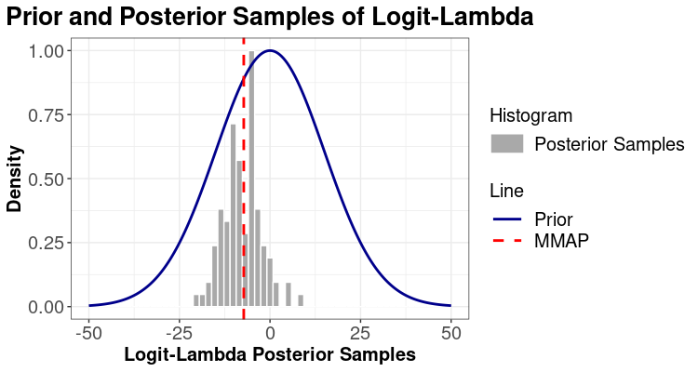
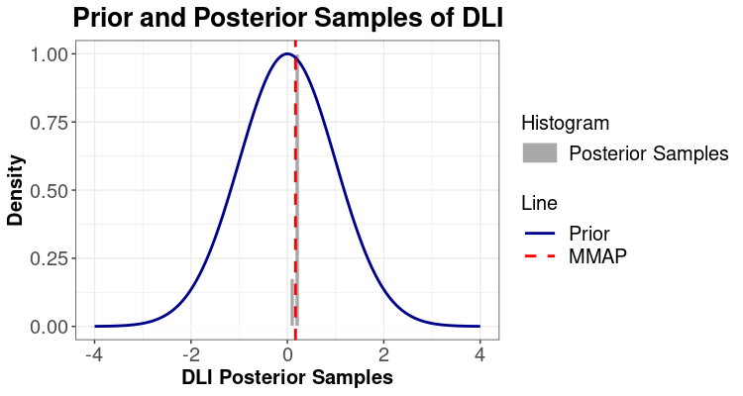


Prior and Posterior

Slide 15
Scenario 4: change (hyper)priors on CAR hyperparameters, enlarge logit lambda normal prior’s SD to 15, precision gamma prior’s SD to 4
(Hyper)Priors Summary
Parameter | Family | Prior parameters
Intercept | Gaussian | mean = 0, sd = 2
LC (DOS, DLI, DMI) | Gaussian | mean = 0, sd = 1
Range (Matérn) | PC | min = 1.5, prob = 0.01
Sigma (Matérn) | PC | max = 0.25, prob = 0.01
Logit Lambda (CAR) | Gaussian | mean = logit(0.5), sd = 15
Precision (CAR) | Gamma | shape = 1, scale = 4

Slide 16
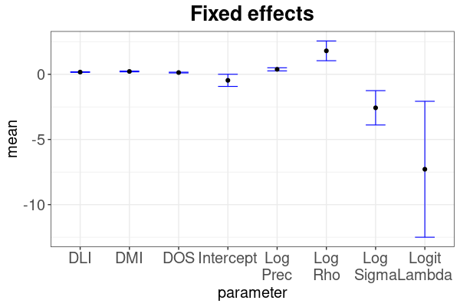
Model Fitting Posterior Summary: Model (Hyper)Parameters Posterior Samples
Model Parameters
Fixed Effects | Mean | Std. Error
Intercept | -0.46 | 0.46
DOS | 0.13 | 0.03
DLI | 0.17 | 0.02
DMI | 0.22 | 0.03
Log-Sigma | -2.57 | 1.32
Log-Rho | 1.80 | 0.76
Logit-Lambda | -7.28 | 5.21
Log-Precision | 0.38 | 0.12
Objective Function-Negative Log Likelihood (NLL) |  | NA
Priors-Negative Log Likelihood (NLL Priors) |  | NA
Out Sample (block) Performance |  | Value
R² |  | 0.70
RMSE |  | 99.27
MAE |  | 42.39
Pearson |  | 0.84
Spearman |  | 0.75
Log-Pearson |  | 0.75

Slide 17


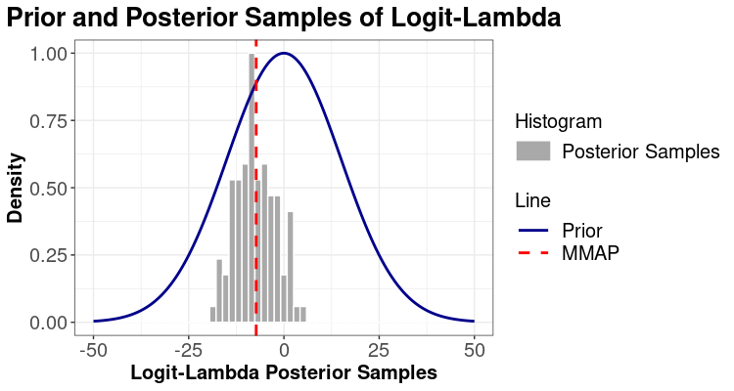


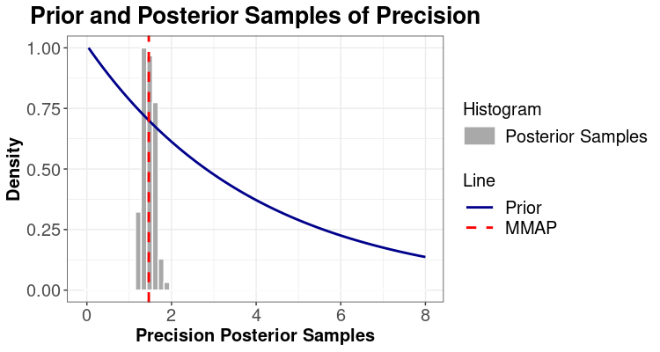
Prior and Posterior

Slide 18
Scenario 5: change (hyper)priors on CAR hyperparameters, enlarge logit lambda normal prior’s SD to 15, precision gamma prior’s SD to 8
(Hyper)Priors Summary
Parameter | Family | Prior parameters
Intercept | Gaussian | mean = 0, sd = 2
LC (DOS, DLI, DMI) | Gaussian | mean = 0, sd = 1
Range (Matérn) | PC | min = 1.5, prob = 0.01
Sigma (Matérn) | PC | max = 0.25, prob = 0.01
Logit Lambda (CAR) | Gaussian | mean = logit(0.5), sd = 15
Precision (CAR) | Gamma | shape = 1, scale = 8

Slide 19
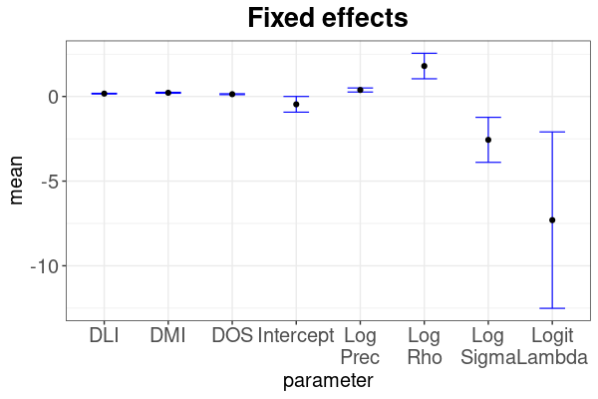
Model Fitting Posterior Summary: Model (Hyper)Parameters Posterior Samples
Model Parameters
Fixed Effects | Mean | Std. Error
Intercept | -0.46 | 0.46
DOS | 0.13 | 0.03
DLI | 0.17 | 0.02
DMI | 0.22 | 0.03
Log-Sigma | -2.56 | 1.33
Log-Rho | 1.80 | 0.75
Logit-Lambda | -7.30 | 5.21
Log-Precision | 0.38 | 0.12
Objective Function-Negative Log Likelihood (NLL) |  | NA
Priors-Negative Log Likelihood (NLL Priors) |  | NA
Out Sample (block) Performance |  | Value
R² |  | 0.70
RMSE |  | 99.27
MAE |  | 42.39
Pearson |  | 0.84
Spearman |  | 0.75
Log-Pearson |  | 0.75

Slide 20
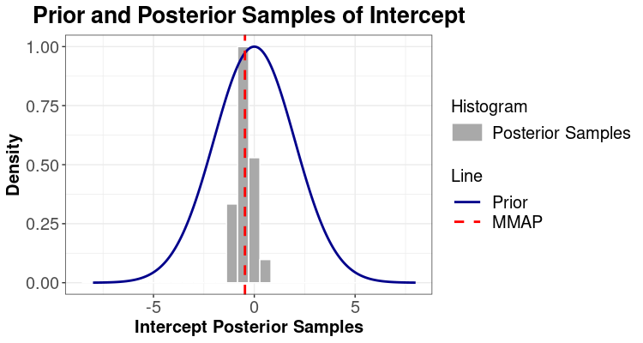

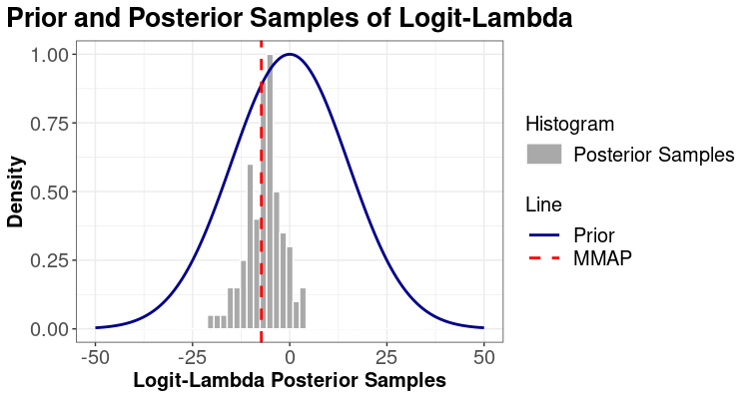


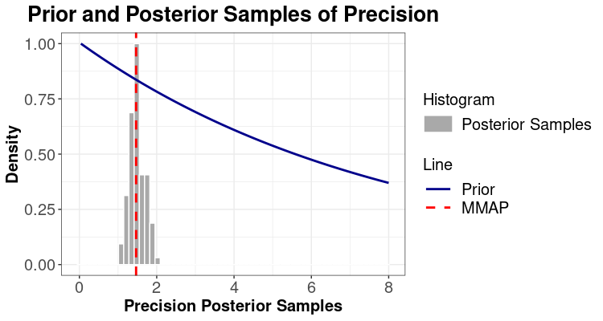
Prior and Posterior

Slide 21
Prior Sensitivity Analysis: Leroux CAR Model Simulation
The same 100 realizations from the Scenario 1
Baseline
Scenario 1: Logit Lambda SD to 1
Hyperpriors Summary
Hyperpriors Summary
Parameter | Family | Prior parameters
Logit-Lambda | Gaussian | mean = logit(0.7), sd = 0.1
Precision | Gamma | shape = 1/3, scale = 1
Parameter | Family | Prior parameters
Logit-Lambda | Gaussian | mean = logit(0.7), sd = 1
Precision | Gamma | shape = 1/3, scale = 1
Scenario 2: Logit Lambda and Precision SD
to 1
Scenario 3: Gamma prior’s mode on true precision
Hyperpriors Summary
Parameter | Family | Prior parameters
Logit-Lambda | Gaussian | mean = logit(0.7), sd = 1
Precision | Gamma | shape = 1 + precision / scale, scale = (-precision + sqrt(precision^2 + 4) ) / 2
Parameter | Family | Prior parameters
Logit-Lambda | Gaussian | mean = logit(0.7), sd = 1
Precision | Gamma | shape = (1/3)^2, scale = 3

Slide 22
Prior Sensitivity Analysis: Leroux CAR Model Simulation
The same 100 realizations from the Scenario 1
Scenario 4: Gamma prior’s mode on the true precision,
enlarge logit-lambda’s normal prior’s SD to 2
Parameter | Family | Prior parameters
Logit-Lambda | Gaussian | mean = logit(0.7), sd = 2
Precision | Gamma | shape = 1 + precision / scale, scale = (-precision + sqrt(precision^2 + 4) ) / 2

Slide 23
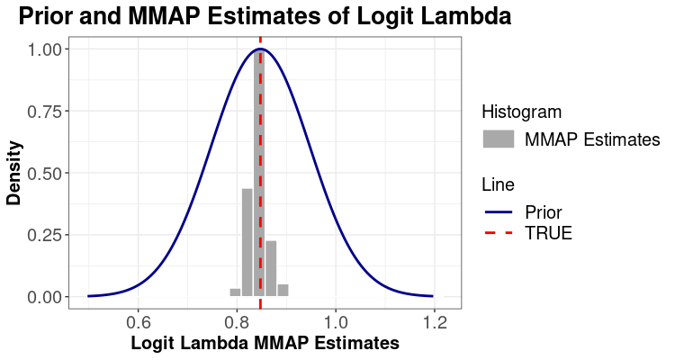
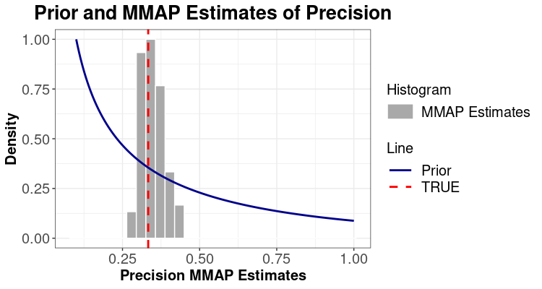
Base Scenario: Gaussian prior’s SD is 0.1
The same 100 realizations from the Scenario 1
Gaussian prior’s mean/mode on the true logit-lambda,
variance is 0.1.
Gamma prior’s mean on the true precision,
variance is 1/3.

Slide 24
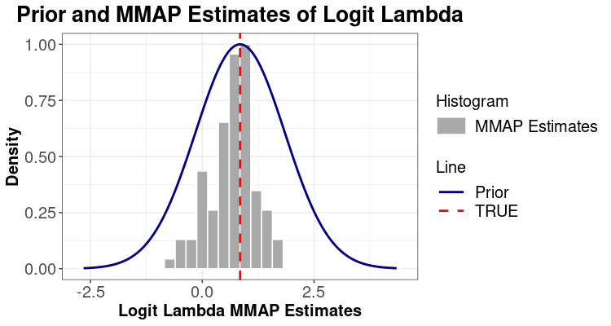
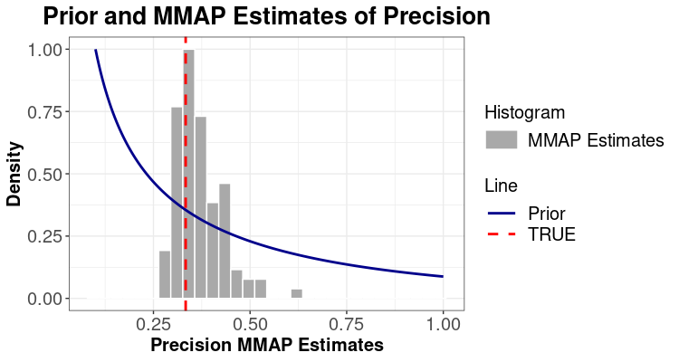
Scenario 1: Prior on Logit Lambda (SD to 1)
The same 100 realizations from the Scenario 1
Gaussian prior’s mean/mode on the true logit-lambda,
variance is 1.
Gamma prior’s mean on the true precision,
variance is 1/3.

Slide 25

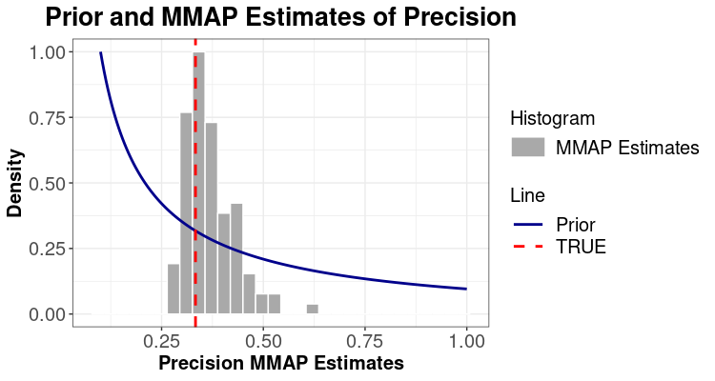
Scenario 2: Prior on both Logit Lambda and Precision (SD to 1)
The same 100 realizations from the Scenario 1
Gaussian prior’s mean/mode on the true logit-lambda,
variance is 1.
Gamma prior’s mean on the true precision,
variance is 1.

Slide 26

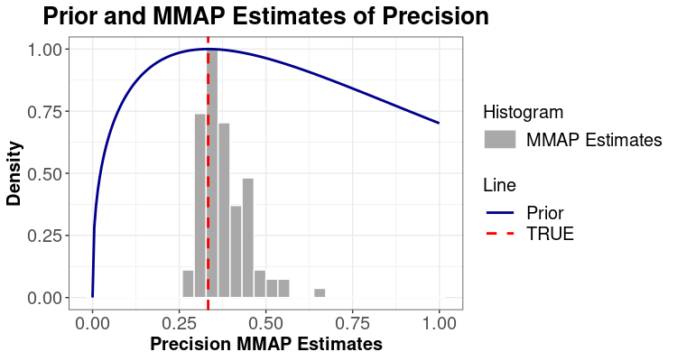
Scenario 3: Gamma prior’s mode on true precision
The same 100 realizations from the Scenario 1
Gaussian prior’s mean/mode on the true logit-lambda,
variance is 1.
Gamma prior’s mode on the true precision,
variance is 1.

Slide 27
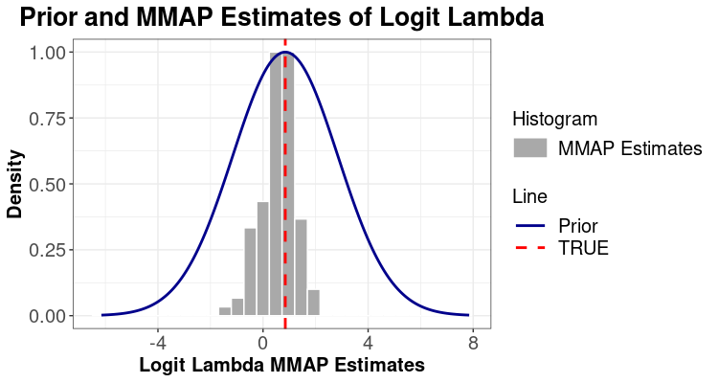
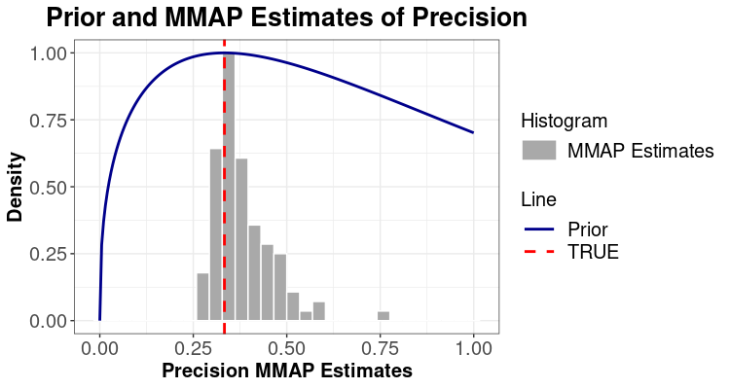
Scenario 4: Gamma prior’s mode on true precision, enlarge logit-lambda’s normal prior’s SD to 2
The same 100 realizations from the Scenario 1
Gaussian prior’s mean/mode on the true logit-lambda,
variance is 2.
Gamma prior’s mode on the true precision,
variance is 1.

Slide 28
Prior Sensitivity Analysis: Integrated Matérn Field and Leroux CAR Model Simulation
Scenario 1: All SD to 1 except precision’s Gamma prior
Baseline
(Hyper)Priors Summary
(Hyper)Priors Summary
Parameter | Family | Prior parameters
Intercept | Gaussian | mean = 2, sd = 0.1
Slope1 | Gaussian | mean = 1, sd = 0.1
Slope2 | Gaussian | mean = 0.5, sd = 0.1
Log-Sigma (marginal variance) | Gaussian | mean = 0, sd = 0.1
Log-Rho (range) | Gaussian | mean = -0.9, sd = 0.1
Logit-Lambda (mixing parameter) | Gaussian | mean = logit(0.7), sd = 0.1
Precision | Gamma | shape = 1/3, scale = 1
Parameter | Family | Prior parameters
Intercept | Gaussian | mean = 2, sd = 1
Slope1 | Gaussian | mean = 1, sd = 1
Slope2 | Gaussian | mean = 0.5, sd = 1
Log-Sigma (marginal variance) | Gaussian | mean = 0, sd = 1
Log-Rho (range) | Gaussian | mean = -0.9, sd = 1
Logit-Lambda (mixing parameter) | Gaussian | mean = logit(0.7), sd = 1
Precision | Gamma | shape = 1/3, scale = 1

Slide 29
Scenario 3: All SD to 1 and Gamma prior’s mode
on the true precision
Scenario 2: All SD to 1
(Hyper)Priors Summary
(Hyper)Priors Summary
Parameter | Family | Prior parameters
Intercept | Gaussian | mean = 2, sd = 1
Slope1 | Gaussian | mean = 1, sd = 1
Slope2 | Gaussian | mean = 0.5, sd = 1
Log-Sigma (marginal variance) | Gaussian | mean = 0, sd = 1
Log-Rho (range) | Gaussian | mean = -0.9, sd = 1
Logit-Lambda (mixing parameter) | Gaussian | mean = logit(0.7), sd = 1
Precision | Gamma | shape = (1/3)^2, scale = 3
Parameter | Family | Prior parameters
Intercept | Gaussian | mean = 2, sd = 1
Slope1 | Gaussian | mean = 1, sd = 1
Slope2 | Gaussian | mean = 0.5, sd = 1
Sigma (marginal variance) | Gaussian | mean = 0, sd = 1
Rho (range) | Gaussian | mean = -0.9, sd = 1
Logit-Lambda (mixing parameter) | Gaussian | mean = logit(0.7), sd = 1
Precision | Gamma | shape = 1 + precision / scale, scale = (-precision + sqrt(precision^2 + 4) ) / 2
The same 100 realizations from the Scenario 1

Slide 30
Scenario 4: All normal priors’ SD to 1 and Gamma prior’s
mode on the true precision, enlarge logit-lambda’s normal
prior’s SD to 2
(Hyper)Priors Summary
Parameter | Family | Prior parameters
Intercept | Gaussian | mean = 2, sd = 1
Slope1 | Gaussian | mean = 1, sd = 1
Slope2 | Gaussian | mean = 0.5, sd = 1
Sigma (marginal variance) | Gaussian | mean = 0, sd = 1
Rho (range) | Gaussian | mean = -0.9, sd = 1
Logit-Lambda (mixing parameter) | Gaussian | mean = logit(0.7), sd = 2
Precision | Gamma | shape = 1 + precision / scale, scale = (-precision + sqrt(precision^2 + 4) ) / 2

Slide 31
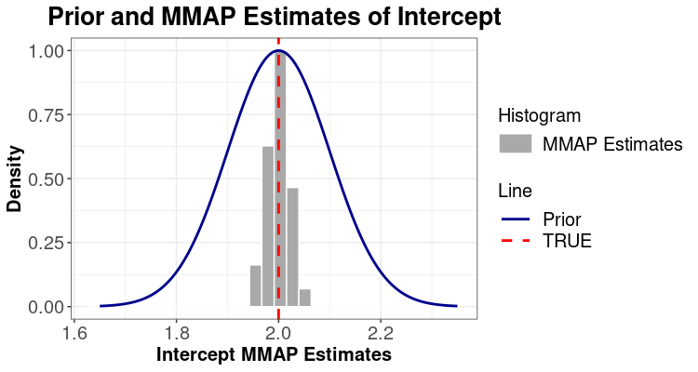
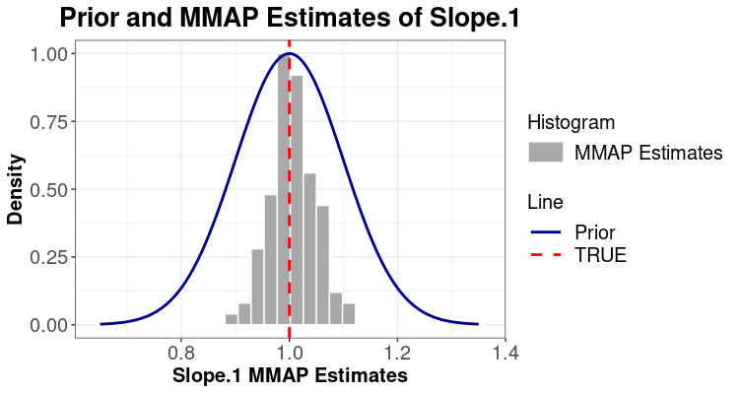
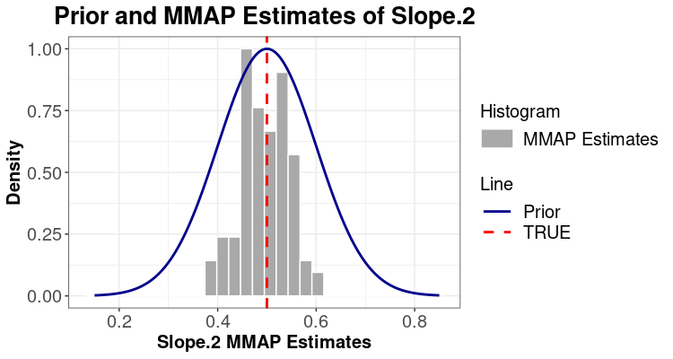
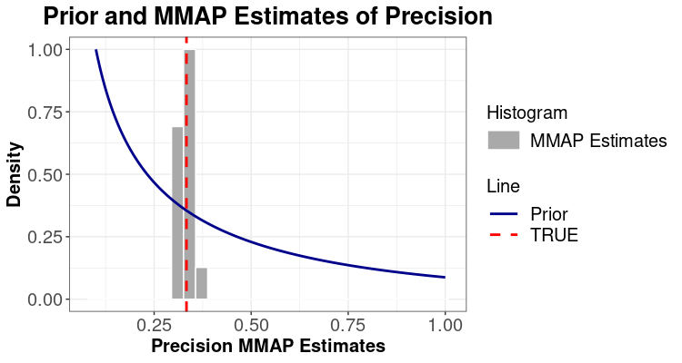
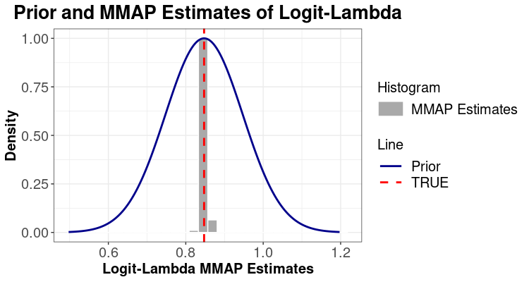
Base Scenario: Gaussian priors’ SD is 0.1

Slide 32
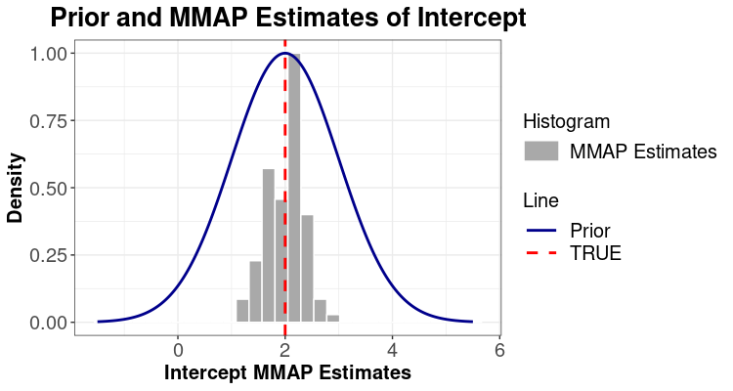
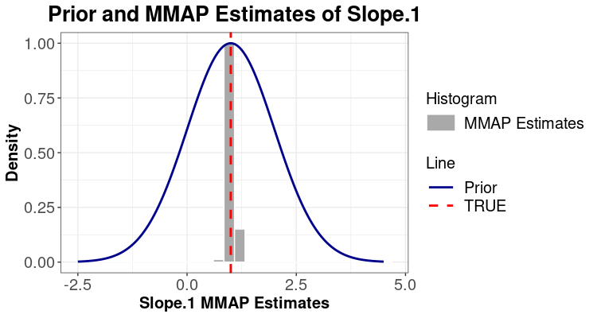

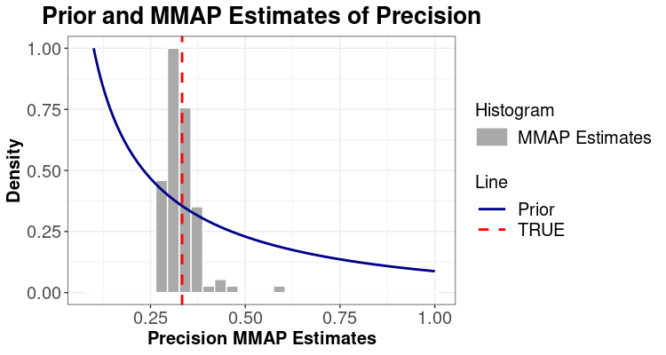
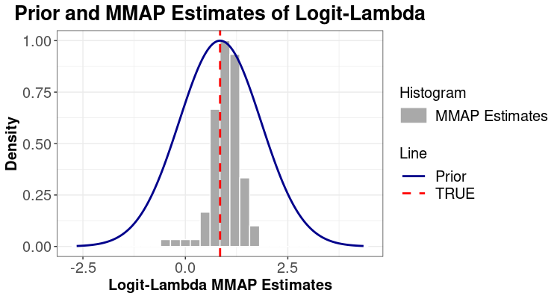
Scenario 1: All hyperpriors’ SD to 1 except precision’s Gamma prior

Slide 33
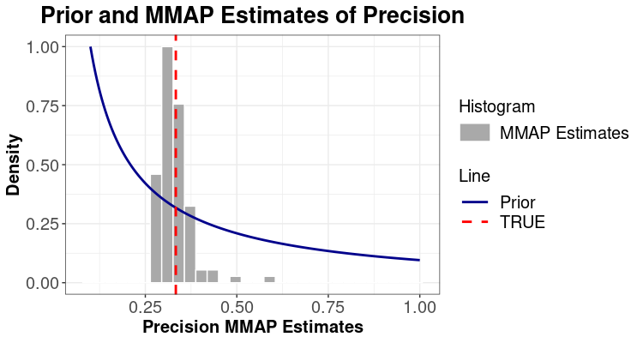

Scenario 2: All hyperprior’s SD to 1

Slide 34

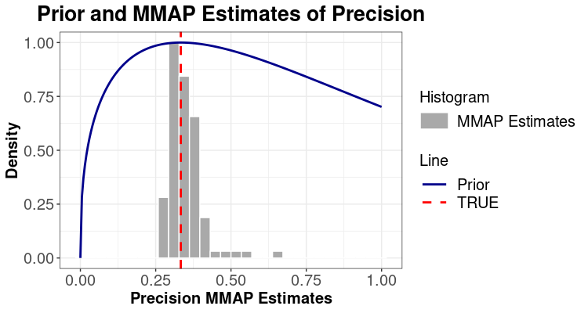
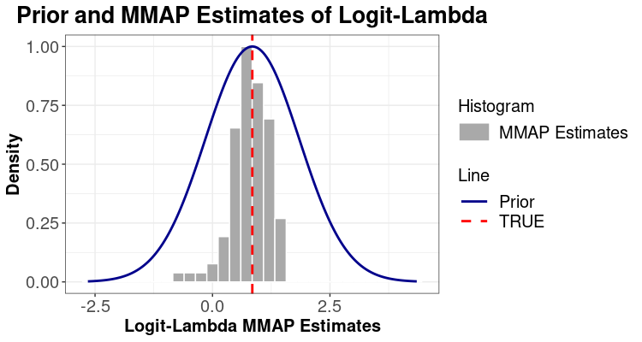
Scenario 3: All (hyper)prior’s SD to 1 and Gamma prior’s mode on the true precision

Slide 35

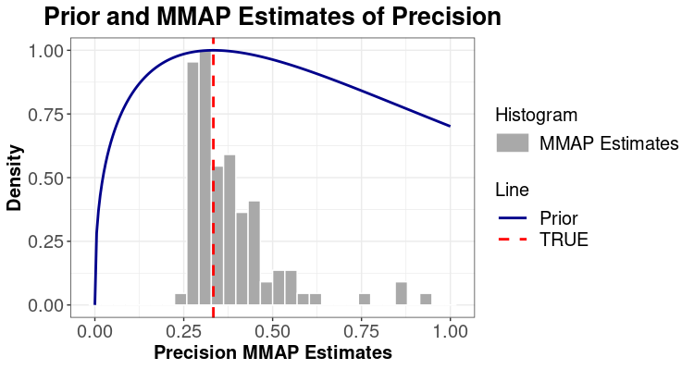
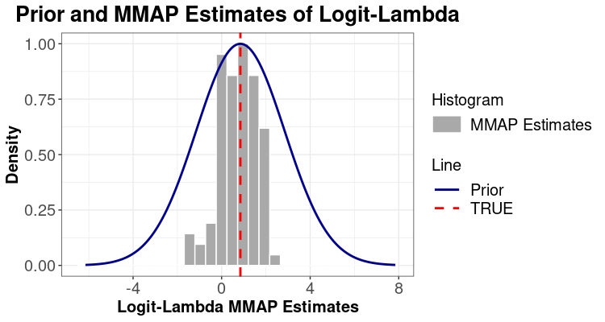
Scenario 4: All normal priors’ SD to 1 and Gamma prior’s mode on the true precision, enlarge logit-lambda’s normal prior’s SD to 2

Slide 36
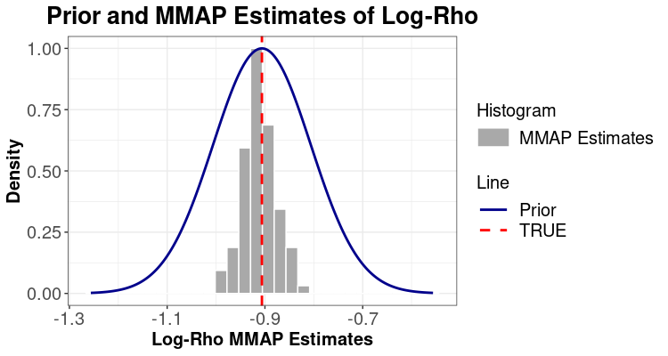





Matérn Field Covariance Parameters
Baseline
Scenario 1: All SD to 1 except precision’s Gamma prior
Scenario 2: All SD to 1
Scenario 3: All SD to 1 and Gamma prior’s mode on the true precision

Slide 37


Matérn Field Covariance Parameters
Scenario 4: All normal priors’ SD to 1 and Gamma prior’s mode on the true precision, enlarge logit-lambda’s normal prior’s SD to 2

Slide 38
Conclusions
Overall, prediction performance of the HPSDRM in the population modeling in the Davidson County, Nashville is not sensitive to the priors’ standard deviations.
Among the land cover regression coefficients, Matérn kernel parameters and Leroux CAR parameters, Matérn kernel parameters are the most sensitive to their priors, and then Leroux CAR parameters are less sensitive to their priors, and land cover regression coefficients are almost not sensitive to their priors at all.
The priors’ sensitivity analysis findings in the case study are again verified in the simulation study where the model parameter estimation for linear regression coefficients and the Leroux CAR parameters are not sensitive to their priors whereas the Matérn kernel parameters remain inconsistent estimable under an infill asymptotic with base space of dimension three or lower (Zhang, 2004).
The reason is that the MLE used in the TMB model cannot consistently estimate all the true parameters of the covariance parameters in the Matérn kernel from observations since the profile likelihood can be multimodal with long flat ridge and a number of local maxima of almost identical height (Warnes and Ripley, 1987). For these GRFs only a limited amount of information can be learned about the parameters from likelihood function from a bounded domain and the prior can certainly affect the behavior of the posterior (Fuglstad, 2019). This is the reason why we want to apply a relatively stronger prior to help likelihood function constrain the posterior for Matérn kernel parameters.
However, even if the true parameters of the Matérn kernel cannot be consistently estimated, the choices of parameters along the ridge of the likelihood function can lead to similar predictive distributions conditional on the observed data (Fuglstad, 2019). Thus, even if there is no consistent estimators for all the Matérn kernel parameters, the interpolation performance remains equal under equivalent measures. The microergodic quantity for the Gaussian GLMM is well studied (Zhang, 2004), however, studying the equivalence of probability measures under non-Gaussian GLMM like Poisson count data is difficult (Zhang, 2004). Thus, studying the model’s interpolation performance based on simulations is preferred instead of parameters estimations for these spatial GRFs (Zhang, 2004).

Slide 39
Reference
Warnes, J. J., & Ripley, B. D. (1987). Problems with likelihood estimation of covariance functions of spatial Gaussian processes. Biometrika, 74(3), 640-642.
Fuglstad, G. A., Simpson, D., Lindgren, F., & Rue, H. (2019). Constructing priors that penalize the complexity of Gaussian random fields. Journal of the American Statistical Association, 114(525), 445-452.
Zhang, H. (2004). Inconsistent estimation and asymptotically equal interpolations in model-based geostatistics. Journal of the American Statistical Association, 99(465), 250-261.

Slide 40
Scenario 1: priors with 2 times of SD of all parameters
(Hyper)Priors Summary
Parameter | Family | Prior parameters
Intercept | Gaussian | mean = 0, sd = 4
LC (DOS, DLI, DMI) | Gaussian | mean = 0, sd = 2
Range (Matérn) | PC | min = 1.5, prob = 0.02
Sigma (Matérn) | PC | max = 0.25, prob = 0.02
Logit Lambda (CAR) | Gaussian | mean = logit(0.8), sd = 2
Precision (CAR) | Gamma | shape = 5, scale = 2

Slide 41







Model Fitting Posterior Summary: Model (Hyper)Parameters Posterior Samples
Model Parameters
Fixed Effects | Mean | Std. Error
Intercept | -0.38 | 0.43
DOS | 0.14 | 0.03
DLI | 0.17 | 0.02
DMI | 0.17 | 0.04
Log-Sigma | -0.83 | 0.44
Log-Rho | 1.52 | 0.30
Logit-Lambda | -4.09 | 0.84
Log-Precision | 0.61 | 0.24
Objective Function-Negative Log Likelihood (NLL) |  | NA
Priors-Negative Log Likelihood (NLL Priors) |  | NA
Out Sample (block) Performance |  | Value
R² |  | 0.68
RMSE |  | 102.22
MAE |  | 43.47
Pearson |  | 0.83
Spearman |  | 0.76
Log-Pearson |  | 0.76

Slide 42
Scenario 2: priors with 2 times of SD of all land cover regression coefficients and intercept only
(Hyper)Priors Summary
Parameter | Family | Prior parameters
Intercept | Gaussian | mean = 0, sd = 4
LC (DOS, DLI, DMI) | Gaussian | mean = 0, sd = 2
Range (Matérn) | PC | min = 1.5, prob = 0.01
Sigma (Matérn) | PC | max = 0.25, prob = 0.01
Logit Lambda (CAR) | Gaussian | mean = logit(0.8), sd = 1
Precision (CAR) | Gamma | shape = 10, scale = 1

Slide 43

Model Fitting Posterior Summary: Model (Hyper)Parameters Posterior Samples
Model Parameters
Fixed Effects | Mean | Std. Error
Intercept | -0.46 | 0.49
DOS | 0.14 | 0.03
DLI | 0.17 | 0.02
DMI | 0.21 | 0.03
Log-Sigma | -2.49 | 1.47
Log-Rho | 1.79 | 0.75
Logit-Lambda | -2.76 | 0.51
Log-Precision | 0.21 | 0.16
Objective Function-Negative Log Likelihood (NLL) |  | NA
Priors-Negative Log Likelihood (NLL Priors) |  | NA
Out Sample (block) Performance |  | Value
R² |  | 0.70
RMSE |  | 99.87
MAE |  | 42.44
Pearson |  | 0.84
Spearman |  | 0.75
Log-Pearson |  | 0.76

Slide 44
Scenario 3: priors with 2 times weaker of penalized probability of all Matérn covariance parameters only
(Hyper)Priors Summary
Parameter | Family | Prior parameters
Intercept | Gaussian | mean = 0, sd = 2
LC (DOS, DLI, DMI) | Gaussian | mean = 0, sd = 1
Range (Matérn) | PC | min = 1.5, prob = 0.02
Sigma (Matérn) | PC | max = 0.25, prob = 0.02
Logit Lambda (CAR) | Gaussian | mean = logit(0.8), sd = 1
Precision (CAR) | Gamma | shape = 10, scale = 1

Slide 45

Model Fitting Posterior Summary: Model (Hyper)Parameters Posterior Samples
Model Parameters
Fixed Effects | Mean | Std. Error
Intercept | -0.37 | 0.41
DOS | 0.15 | 0.03
DLI | 0.18 | 0.02
DMI | 0.14 | 0.05
Log-Sigma | -0.52 | 0.34
Log-Rho | 1.45 | 0.25
Logit-Lambda | -2.90 | 0.53
Log-Precision | 0.66 | 0.28
Objective Function-Negative Log Likelihood (NLL) |  | NA
Priors-Negative Log Likelihood (NLL Priors) |  | NA
Out Sample (block) Performance |  | Value
R² |  | 0.65
RMSE |  | 106.99
MAE |  | 45.75
Pearson |  | 0.81
Spearman |  | 0.75
Log-Pearson |  | 0.75

Slide 46
Scenario 4: priors with 2 times of SD of all Leroux CAR covariance parameters only
(Hyper)Priors Summary
Parameter | Family | Prior parameters
Intercept | Gaussian | mean = 0, sd = 2
LC (DOS, DLI, DMI) | Gaussian | mean = 0, sd = 1
Range (Matérn) | PC | min = 1.5, prob = 0.01
Sigma (Matérn) | PC | max = 0.25, prob = 0.01
Logit Lambda (CAR) | Gaussian | mean = logit(0.8), sd = 2
Precision (CAR) | Gamma | shape = 5, scale = 2

Slide 47

Model Fitting Posterior Summary: Model (Hyper)Parameters Posterior Samples
Model Parameters
Fixed Effects | Mean | Std. Error
Intercept | -0.46 | 0.47
DOS | 0.14 | 0.03
DLI | 0.17 | 0.02
DMI | 0.21 | 0.03
Log-Sigma | -2.53 | 1.39
Log-Rho | 1.80 | 0.75
Logit-Lambda | -3.85 | 0.84
Log-Precision | 0.33 | 0.14
Objective Function-Negative Log Likelihood (NLL) |  | NA
Priors-Negative Log Likelihood (NLL Priors) |  | NA
Out Sample (block) Performance |  | Value
R² |  | 0.70
RMSE |  | 99.43
MAE |  | 42.37
Pearson |  | 0.84
Spearman |  | 0.75
Log-Pearson |  | 0.76

Slide 48
Scenario 5: 4 times weaker of the penalized probability of PC prior for Sigma
(Hyper)Priors Summary
Parameter | Family | Prior parameters
Intercept | Gaussian | mean = 0, sd = 4
LC (DOS, DLI, DMI) | Gaussian | mean = 0, sd = 2
Range (Matérn) | PC | min = 1.5, prob = 0.02
Sigma (Matérn) | PC | max = 0.25, prob = 0.04
Logit Lambda (CAR) | Gaussian | mean = logit(0.8), sd = 2
Precision (CAR) | Gamma | shape = 5, scale = 2

Slide 49

Model Fitting Posterior Summary: Model (Hyper)Parameters Posterior Samples
Model Parameters
Fixed Effects | Mean | Std. Error
Intercept | -0.39 | 0.42
DOS | 0.14 | 0.03
DLI | 0.18 | 0.02
DMI | 0.16 | 0.04
Log-Sigma | -0.64 | 0.33
Log-Rho | 1.47 | 0.27
Logit-Lambda | -4.11 | 0.84
Log-Precision | 0.70 | 0.24
Objective Function-Negative Log Likelihood (NLL) |  | NA
Priors-Negative Log Likelihood (NLL Priors) |  | NA
Out Sample (block) Performance |  | Value
R² |  | 0.67
RMSE |  | 104.04
MAE |  | 44.34
Pearson |  | 0.82
Spearman |  | 0.75
Log-Pearson |  | 0.76

Slide 50
Scenario 6: 2 times weaker of the penalized probability of PC prior for Sigma from 2 times of maximum sigma
(Hyper)Priors Summary
Parameter | Family | Prior parameters
Intercept | Gaussian | mean = 0, sd = 4
LC (DOS, DLI, DMI) | Gaussian | mean = 0, sd = 2
Range (Matérn) | PC | min = 1.5, prob = 0.02
Sigma (Matérn) | PC | max = 0.50, prob = 0.02
Logit Lambda (CAR) | Gaussian | mean = logit(0.8), sd = 2
Precision (CAR) | Gamma | shape = 5, scale = 2

Slide 51

Model Fitting Posterior Summary: Model (Hyper)Parameters Posterior Samples
Model Parameters
Fixed Effects | Mean | Std. Error
Intercept | -0.45 | 0.42
DOS | 0.15 | 0.03
DLI | 0.18 | 0.02
DMI | 0.14 | 0.04
Log-Sigma | -0.39 | 0.25
Log-Rho | 1.41 | 0.25
Logit-Lambda | -4.08 | 0.84
Log-Precision | 0.86 | 0.25
Objective Function-Negative Log Likelihood (NLL) |  | NA
Priors-Negative Log Likelihood (NLL Priors) |  | NA
Out Sample (block) Performance |  | Value
R² |  | 0.65
RMSE |  | 107.40
MAE |  | 45.99
Pearson |  | 0.81
Spearman |  | 0.75
Log-Pearson |  | 0.75

Slide 52
Scenario 7: 4 times weaker of the penalized probability of PC prior for Rho
(Hyper)Priors Summary
Parameter | Family | Prior parameters
Intercept | Gaussian | mean = 0, sd = 4
LC (DOS, DLI, DMI) | Gaussian | mean = 0, sd = 2
Range (Matérn) | PC | min = 1.5, prob = 0.04
Sigma (Matérn) | PC | max = 0.25, prob = 0.02
Logit Lambda (CAR) | Gaussian | mean = logit(0.8), sd = 2
Precision (CAR) | Gamma | shape = 5, scale = 2

Slide 53

Model Fitting Posterior Summary: Model (Hyper)Parameters Posterior Samples
Model Parameters
Fixed Effects | Mean | Std. Error
Intercept | -0.38 | 0.43
DOS | 0.14 | 0.03
DLI | 0.17 | 0.02
DMI | 0.17 | 0.04
Log-Sigma | -0.82 | 0.43
Log-Rho | 1.50 | 0.30
Logit-Lambda | -4.09 | 0.84
Log-Precision | 0.61 | 0.24
Objective Function-Negative Log Likelihood (NLL) |  | NA
Priors-Negative Log Likelihood (NLL Priors) |  | NA
Out Sample (block) Performance |  | Value
R² |  | 0.68
RMSE |  | 102.23
MAE |  | 43.48
Pearson |  | 0.83
Spearman |  | 0.76
Log-Pearson |  | 0.76

Slide 54
Scenario 8: 8 times weaker of the penalized probability of PC prior for both range and sigma
(Hyper)Priors Summary
Parameter | Family | Prior parameters
Intercept | Gaussian | mean = 0, sd = 4
LC (DOS, DLI, DMI) | Gaussian | mean = 0, sd = 2
Range (Matérn) | PC | min = 1.5, prob = 0.08
Sigma (Matérn) | PC | max = 0.25, prob = 0.08
Logit Lambda (CAR) | Gaussian | mean = logit(0.8), sd = 2
Precision (CAR) | Gamma | shape = 5, scale = 2

Slide 55

Model Fitting Posterior Summary: Model (Hyper)Parameters Posterior Samples
Model Parameters
Fixed Effects | Mean | Std. Error
Intercept | -0.43 | 0.42
DOS | 0.15 | 0.03
DLI | 0.18 | 0.02
DMI | 0.15 | 0.04
Log-Sigma | -0.48 | 0.28
Log-Rho | 1.41 | 0.25
Logit-Lambda | -4.10 | 0.84
Log-Precision | 0.79 | 0.25
Objective Function-Negative Log Likelihood (NLL) |  | NA
Priors-Negative Log Likelihood (NLL Priors) |  | NA
Out Sample (block) Performance |  | Value
R² |  | 0.66
RMSE |  | 105.85
MAE |  | 45.21
Pearson |  | 0.81
Spearman |  | 0.75
Log-Pearson |  | 0.75

Slide 56
Scenario 9: 2 times weaker of the penalized probability of PC prior for both range at minimum of 0.75 and sigma at maximum of 0.5
(Hyper)Priors Summary
Parameter | Family | Prior parameters
Intercept | Gaussian | mean = 0, sd = 4
LC (DOS, DLI, DMI) | Gaussian | mean = 0, sd = 2
Range (Matérn) | PC | min = 0.75, prob = 0.02
Sigma (Matérn) | PC | max = 0.5, prob = 0.02
Logit Lambda (CAR) | Gaussian | mean = logit(0.8), sd = 2
Precision (CAR) | Gamma | shape = 5, scale = 2

Slide 57

Model Fitting Posterior Summary: Model (Hyper)Parameters Posterior Samples
Model Parameters
Fixed Effects | Mean | Std. Error
Intercept | -0.47 | 0.41
DOS | 0.15 | 0.03
DLI | 0.18 | 0.02
DMI | 0.15 | 0.04
Log-Sigma | -0.38 | 0.25
Log-Rho | 1.37 | 0.25
Logit-Lambda | -4.09 | 0.84
Log-Precision | 0.87 | 0.25
Objective Function-Negative Log Likelihood (NLL) |  | NA
Priors-Negative Log Likelihood (NLL Priors) |  | NA
Out Sample (block) Performance |  | Value
R² |  | 0.65
RMSE |  | 107.29
MAE |  | 45.93
Pearson |  | 0.81
Spearman |  | 0.75
Log-Pearson |  | 0.75

Slide 58
Scenario 10: 2 times weaker of the penalized probability of PC prior for both range at minimum of 0.4 and sigma at maximum of 1
(Hyper)Priors Summary
Parameter | Family | Prior parameters
Intercept | Gaussian | mean = 0, sd = 4
LC (DOS, DLI, DMI) | Gaussian | mean = 0, sd = 2
Range (Matérn) | PC | min = 0.4, prob = 0.02
Sigma (Matérn) | PC | max = 1, prob = 0.02
Logit Lambda (CAR) | Gaussian | mean = logit(0.8), sd = 2
Precision (CAR) | Gamma | shape = 5, scale = 2

Slide 59

Model Fitting Posterior Summary: Model (Hyper)Parameters Posterior Samples
Model Parameters
Fixed Effects | Mean | Std. Error
Intercept | -0.55 | 0.41
DOS | 0.15 | 0.03
DLI | 0.18 | 0.02
DMI | 0.14 | 0.04
Log-Sigma | -0.22 | 0.22
Log-Rho | 1.30 | 0.24
Logit-Lambda | -4.04 | 0.86
Log-Precision | 1.0 | 0.27
Objective Function-Negative Log Likelihood (NLL) |  | NA
Priors-Negative Log Likelihood (NLL Priors) |  | NA
Out Sample (block) Performance |  | Value
R² |  | 0.63
RMSE |  | 109.62
MAE |  | 47.11
Pearson |  | 0.80
Spearman |  | 0.74
Log-Pearson |  | 0.74

Slide 60
Scenario 10: 4 times weaker of the penalized probability of PC prior for both range at minimum of 0.75 and sigma at maximum of 0.5
(Hyper)Priors Summary
Parameter | Family | Prior parameters
Intercept | Gaussian | mean = 0, sd = 4
LC (DOS, DLI, DMI) | Gaussian | mean = 0, sd = 2
Range (Matérn) | PC | min = 0.75, prob = 0.04
Sigma (Matérn) | PC | max = 0.5, prob = 0.04
Logit Lambda (CAR) | Gaussian | mean = logit(0.8), sd = 2
Precision (CAR) | Gamma | shape = 5, scale = 2

Slide 61

Model Fitting Posterior Summary: Model (Hyper)Parameters Posterior Samples
Model Parameters
Fixed Effects | Mean | Std. Error
Intercept | -0.50 | 0.41
DOS | 0.15 | 0.03
DLI | 0.18 | 0.02
DMI | 0.14 | 0.04
Log-Sigma | -0.32 | 0.23
Log-Rho | 1.35 | 0.25
Logit-Lambda | -4.07 | 0.85
Log-Precision | 0.91 | 0.26
Objective Function-Negative Log Likelihood (NLL) |  | NA
Priors-Negative Log Likelihood (NLL Priors) |  | NA
Out Sample (block) Performance |  | Value
R² |  | 0.64
RMSE |  | 108.14
MAE |  | 46.36
Pearson |  | 0.81
Spearman |  | 0.75
Log-Pearson |  | 0.75

Slide 62
Scenario 11: 4 times weaker of the penalized probability of PC prior for both range at minimum of 0.4 and sigma at maximum of 1
(Hyper)Priors Summary
Parameter | Family | Prior parameters
Intercept | Gaussian | mean = 0, sd = 4
LC (DOS, DLI, DMI) | Gaussian | mean = 0, sd = 2
Range (Matérn) | PC | min = 0.4, prob = 0.04
Sigma (Matérn) | PC | max = 1, prob = 0.04
Logit Lambda (CAR) | Gaussian | mean = logit(0.8), sd = 2
Precision (CAR) | Gamma | shape = 5, scale = 2

Slide 63

Model Fitting Posterior Summary: Model (Hyper)Parameters Posterior Samples
Model Parameters
Fixed Effects | Mean | Std. Error
Intercept | -0.57 | 0.41
DOS | 0.15 | 0.03
DLI | 0.19 | 0.02
DMI | 0.14 | 0.04
Log-Sigma | -0.19 | 0.21
Log-Rho | 1.29 | 0.25
Logit-Lambda | -4.02 | 0.86
Log-Precision | 1.02 | 0.28
Objective Function-Negative Log Likelihood (NLL) |  | NA
Priors-Negative Log Likelihood (NLL Priors) |  | NA
Out Sample (block) Performance |  | Value
R² |  | 0.63
RMSE |  | 110.01
MAE |  | 47.30
Pearson |  | 0.80
Spearman |  | 0.74
Log-Pearson |  | 0.74

